Slide 1
MAW3®
Tissue Banking
Raj C. Dash, MD, Chris Hubbard MCSE, and Alan D. Proia, MD PhD
Duke University Medical Center

Slide 2
Summary
MAW3 Tissue Banking Effort Collaboration
  Duke University School of Medicine Research Foundation (Alan Proia)
  Cancer Center Shared Resource for Tissue and Blood Procurement (Raj Dash)
  Cancer Center Breast SPORE Banking Program (Joseph Geradts)
  And very soon…
    Duke Institute for Genome Sciences and Policy blood and serum banking program in collaboration with RTI

Slide 3
Goals
To create a comprehensive bank including:
  Immediately frozen and paraffin-embedded tumor samples and matched non-neoplastic tissue
  Blood components before and after surgery and prior to chemotherapy
To collect longitudinal clinical data for the subjects from whom we have collected tissue and blood components

Slide 4
Services
Consenting patients
Tissue collection, bar coding, and processing
Clinical and pathology data abstraction
Repository management
  Sample storage and distribution
Pathology verification and in the future, photomicroscopy
Assist with access to surgical pathology archives

Slide 5
Facilities
Dedicated consent rooms (two; 65 ft2 each)
Offices, specimen processing, and short-term storage facility (1,000 ft2)
Long-term storage (-185oC freezers; 300 ft2)
Computer server for secure data storage
Pathology Department Research Immunohistology Laboratory: Histology, histochemistry, and immunohistology facilities available for this shared resource

Slide 6
Medical Assistant on the
World Wide Web (MAW3®)
A centralized, multi-institutional medical document database
To fulfill the need for a centralized electronic medical record (EMR) for applications not fulfilled by traditional LIS (Lab Info. Sys.)
  Currently serves as Autopsy and Tissue Banking Information System at Duke
Security is critical
Notes:
Easy and reliable access to medical records is a necessity for patient care. Unfortunately, even within a single institution, such access is often suboptimal. Paper-based records are often damaged, misplaced, or lost entirely. While computer-based medical records offer a vast improvement in both reliability and access, many information systems in place today limit access to an individual department within a single institution. In the past few years, implementation of an integrated electronic patient medical record has been in the spotlight in the informatics community. Such a record would ideally encompass all information pertinent to patient care including diverse topics such as clinical history, radiology, laboratory data, and anatomic pathology and make such information available to all members of a health care system. ¹
A step beyond the integrated electronic medical record, is the concept of an international integrated medical database. Such a system would be multi-institutional (or perhaps "non-institutional" is a better descriptor). A centralized international medical database would provide easy, reliable, and complete access to medical records regardless of location. It would also provide a revolutionary research tool for physicians and scientists by allowing both unparalleled access to "live" medical information and an invaluable resource for outcomes analysis.
The "Medical Assistant on the World Wide Web" project, while focusing on the field of autopsy pathology, will be a prototype for a full-fledged international medical database and will leverage the latest, cutting-edge Internet technologies. The breadth of this project was narrowed to include only autopsy pathology for several reasons. First, a streamlined, working model for autopsy data-entry and report formatting is already in place at Duke University Medical Center using a custom software tool called "Autopsy Assistant." Second, the scope of the project required limitation to allow completion within a reasonable timeframe. Third, masking patient identifiers in autopsy data is somewhat easier due to the structured nature of the autopsy report. Finally, autopsy data inherently provides an excellent source for rigorous outcomes analysis.
The proposed system will facilitate data entry through robust use of templates and automated SNOMED coding. Data analysis and data-mining tools will enhance retrieval and manipulation of entered data. Finally, rich dynamic HTML formatting (an Internet Web document format) will provide professional and flexible reporting of data, including multimedia content. Designed to be open for use by any institution around the globe with Internet access, "Medical Assistant on the World Wide Web" will provide a glimpse into the future of medical information systems.

Slide 7
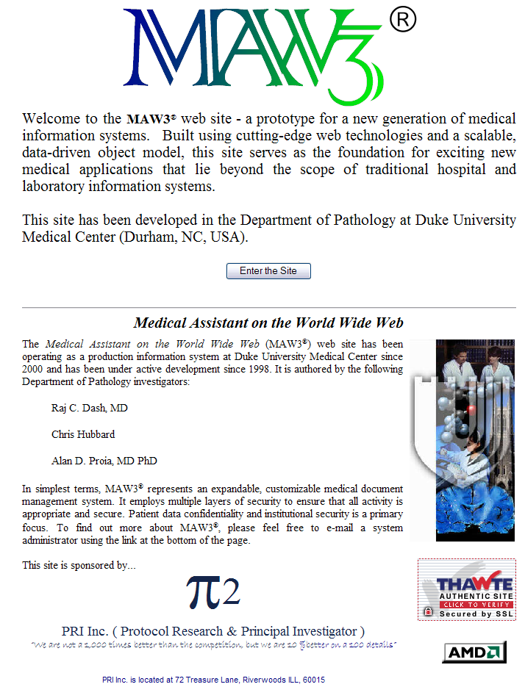
MAW3 Key Components
Data entry
Data storage
Data reporting
Very flexible – multiple data paradigms

Slide 8
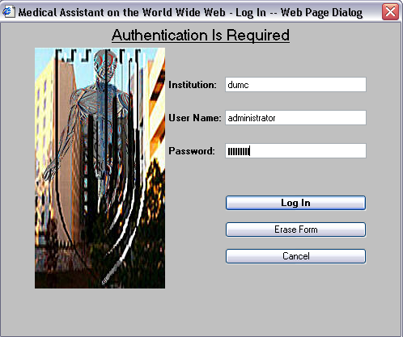
1st Step: Security

Slide 9
MAW3 Security
Kerberos-style continuous authentication with “tickets” passed along with each server request.
  Employment of SSL obviates need for third party Kerberos authentication.
  All data between client & server encrypted
Multiple log-ins allowed but monitored.
  Shared data access (up to level of a report section) allowed.
Automatic “ticket” expiration.
Granular security levels, configurable per user per institution and per report and per function.
Full audit trails for view/modify/query/delete

Slide 10
Introduction to Internet Technologies:
The Client
Client (Web Browser)
  REQUIRES Internet Explorer 6.0 at this time (running on Windows platform)
  Client-side code distribution for scalability
    Dynamic HTML
    Javascript (or other scripting language)
    Java Applets
    ActiveX Controls
  Security strictly enforced
  XML/XHTML document format

Slide 11
Data Entry
  Web browser client = Internet Explorer 6.0
    Universal access
    Client-based programming logic
    Rich graphical user interface
  WYSIWIG editor
    Mimic MS Word
    Edit a single report “section” at one time (configurable)
  Templates and Speed Phrases
    SNOMED “hard-coded” into templates
  Semi-automatic SNOMED CT encoding possible
Notes:
The design and implementation of such a system requires careful planning and execution. To meet the primary goal, four subgoals have been identified. The first subgoal is to provide a means for data access and entry. Use of a low-cost, ubiquitous technology would be ideal. The Internet and World Wide Web provide a consummate solution as most medical centers in developed countries already have this technology in place today. While the problem of universal access may be solved, use of the Internet and web-based technology raises additional issues. Foremost among them is the degree of security afforded over a publicly accessible network such as the Internet. The topic of web-based security and security in general will be addressed separately.
Once data access is available, efficient data entry must be permitted. Use of a computerized input system can greatly facilitate entry of autopsy data through the use of templates and "speed phrases." Templates provide pre-typed detailed descriptions for commonly occurring disease states, using a "fill-in-the-blank" approach to enter only the information specific to the current case. For example, part of a template for a description of the bone marrow may be predefined as "The bone marrow is (hyper/hypo)cellular overall averaging approximately ____% cellularity. There is (no / a mild / a moderate / a severe) (increase / decrease) in the myeloid to erythroid ratio which is approximately _:_ …". While the primary benefit of templates is the increased efficiency in which data is entered, use of templates also promotes systematic evaluation of issues pertinent to the particular topic. In addition, a standard presentation format inherently results from the use of templates.
"Speed phrases" are another mechanism by which data is more efficiently entered. Using this scheme, a short alphanumeric code, followed by a special command key results in expansion of that code into predefined text that corresponds to the entered code. For example, entry of "ned1" followed by the special command key would result in the automatic entry of the phrase "there is no evidence of dysplasia or carcinoma".

Slide 12
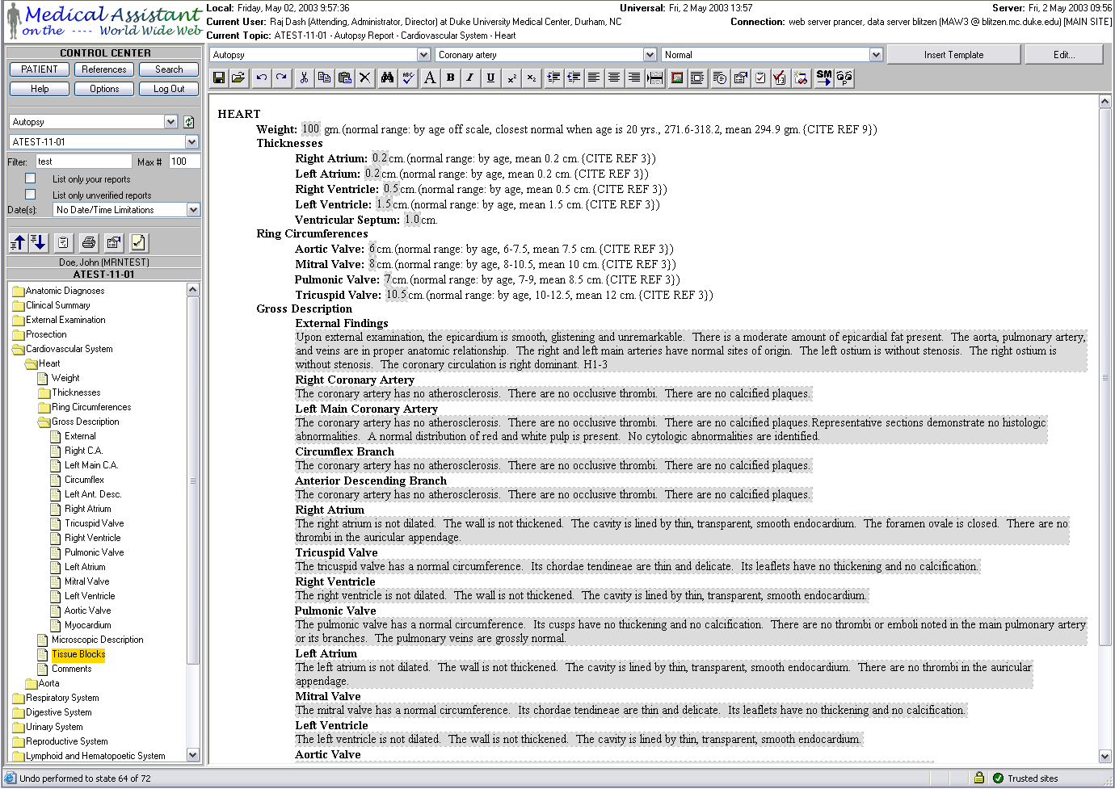
Template-driven data entry

Slide 13
Introduction to Internet Technologies:
The Server
Server (Web Server)
  Active Server Pages (.NET)
    JavaScript (or other scripting languages)
  Designed for database access
    ODBC, OLEDB, ADO
    Facilitate communication with database server

Slide 14
Data Storage
Web server
  MS Internet Information Server
  Server-side programming logic
    Active server pages
Relational database server
  SQL Server 2000
    Database design critical for functionality / flexibility
  Storage of SNOMED reference tables
    Terms, relationships etc.
Within the document itself
  Another dedicated field
  XML
Notes:
Once a user has entered the data, it must be stored in such a manner that it is easily retrievable. To accomplish this objective, the SNOMED classification system will be employed to index textual information. SNOMED employs multiple codes spanning multiple categorical axes to encode a single medical concept. For example to encode the diagnosis of "squamous cell carcinoma of the right lung", separate codes are used to indicate topography or location (a T code), general morphology (an M code), and actual diagnosis (a D code). The efficiency with which SNOMED encodes medically related information and allows accurate and precise retrieval of information has been well documented. ⁶ Classification-based encoding systems have fared quite poorly in this regard.
Once SNOMED encoding is complete, the entered data along with the associated SNOMED codes are stored in a relational (SQL) database. Storage of image data requires special attention due to the inherently large storage requirements for digital image capture. The field of anatomic pathology (as well as a number of other medical fields) revolves around recognition of images and visual patterns as they provide a snapshot of a disease process. Standards for image data representation and communication have been developed (DICOM) and their application will be explored. Encompassing visual information is crucial to an anatomic pathology database. However, due to the tremendous storage requirements of image data, linking of externally stored image information to the database will be promoted rather than actual storing of image data within the central database. This will undoubtedly result in increased maintenance to ensure data integrity and performance degradation when image retrieval and manipulation is required. However, these deficits will be more than offset by the performance improvement in retrieval of non-image data and the data storage resources saved.
Retrieval of information will be allowed through multiple avenues. Retrieval of information based strictly on SNOMED coding will result in superior performance. If SNOMED coding fails to adequately capture the needed information, free-text searching will be permitted. In addition, Boolean operators such as AND, OR, and NOT and "wildcard" characters matching various data patterns will be available to generate sophisticated search queries.
The volumes of information that this system is designed to encode must be analyzed to be useful. Data-mining tools will be employed to automate this process. Automated data-mining tools have the potential to sift through tremendous quantities of information to discover new, previously unrecognized patterns of data associated with specific disease processes.⁷ A number of diverse technologies have been employed for such purposes in the past. These technologies include expert or rule-based systems, neural networks, and fuzzy logic. The effectiveness of various artificial intelligence motifs in the automated analysis and retrieval of data will be a notable and exciting area of research in this project.

Slide 15
Multiple Repository Support
Data Distribution Scenarios
Repository
A
Data Storage A
Repository
B
WYSIWYG
GUI
DISTRIBUTED
OLE DB
CENTRAL
Query Interface
MAW3
SNOMED CT
(Index Storage A, B)
Data Storage B

Slide 16
Client-Server Communications
Traditional
  Make request (via HTML, script, applet)
  Send request to server (followed by pause, delay)
  Server sends back response in the form of a new page
MAW3 Web Services
  Dynamic requests (via software)
  Request to server in the background (transparent)
  Dynamic response (synchronous or asynchronous) provides more efficient multitasking
  aka AJAX, Remote Scripting, Web Services

Slide 17
Data Reporting
HTML/XML formatted document (XHTML)
  Rich formatting control (e.g. absolute positioning)
  Professional printed output (e.g. headers, page breaks)
  Easily exported to traditional word processors
  XML allows easy import of structured data
    Custom MAW3 tags (utilizing maw3 namespace)
Retrieval of data
  Structured query language (SQL) with user-exposed Boolean functionality
  SNOMED CT also possible for advanced queries
    an index for faster data retrieval
    A hierarchical knowledge-base for better data retrieval
Notes:
The third aspect of the proposed project will involve presentation of the archived data to the outside world. The World Wide Web employs a document formatting language entitled HyperText Markup Language (HTML) for this purpose. In the past few years, this language has evolved from a static, simplistic and crude modality for data presentation into a dynamic, precise and robust one. The advent of enhanced server-side programmability and the development of client-side "Dynamic HTML" has dramatically increased the degree of control and flexibility with which web pages can be designed and presented to the end user.
Communication of data to the end user is just one part of the picture. The proposed system should have the facility to communicate with other computer systems. In particular, import and export of data from legacy information systems must be supported. The Health-Level-7 (HL7) communication protocol was designed for such a purpose. HL7 provides a standard by which disparate information systems may communicate using an array of standardized messaging protocols. "Medical Assistant on the World Wide Web" will utilize an HL7 interface to retrieve stored autopsy data from legacy information systems. This will allow rapid accumulation of data and immediate availability of a usable knowledge base. If possible, the system will attempt to store updated and newly entered data back into an institution’s information system.

Slide 18
The Process for Tissue Banking
INFORMED CONSENT
CONSENT TRACKING
SURGERY
DATA TRACKING
TISSUE BANKING
SAMPLE TRACKING (ASM)
DATA COLLECTION
CASE RELEASE

Slide 19
MAW3 - - - Basic Functions
MAW3
  Data entry at point of data collection
    Front-end SNOMED CT coding via templates
  Data storage in native format of institution
  Data queries
    Daily tracking
    QA
    Research
    Back-end coding in SNOMED CT for data retrieval based on flexible (not predetermined) criteria
  Link to patient (secure PHI)
C.O.M.E.T.

Slide 20
MAW3 Data Storage
Tissue Banking Report
(Hemi-hepatectomy
July 2002)
Lab Data Report
(CEA Mar 2002)
Lab Data Report
(CEA June 2002)
Patient
Tissue Banking Report
(Colectomy, Jan 2002)
Lab Data Report
(CEA Oct 2002)
Outside Slide Review
(Jan 2002)
Autopsy
(Jan 2003)

Slide 21
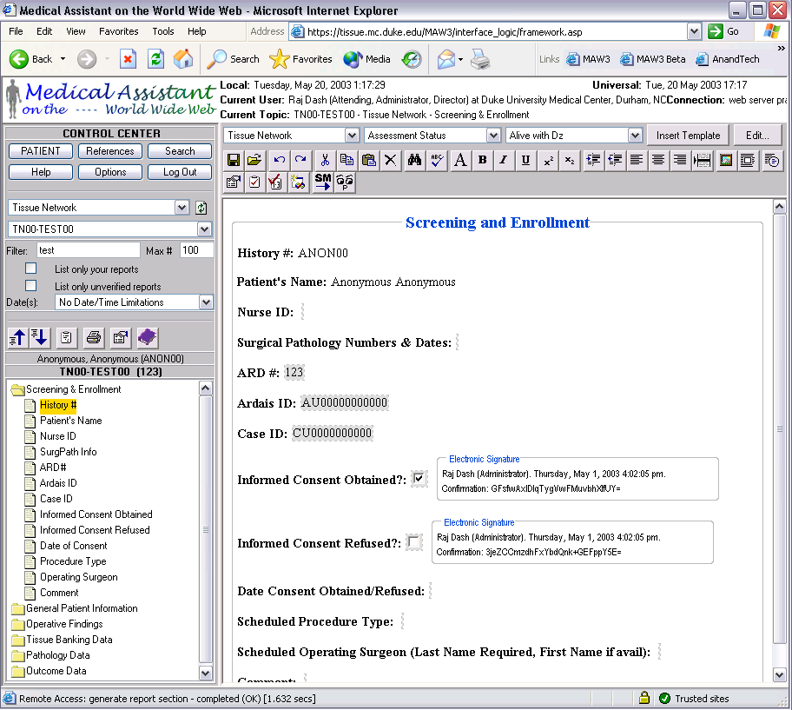

Slide 22
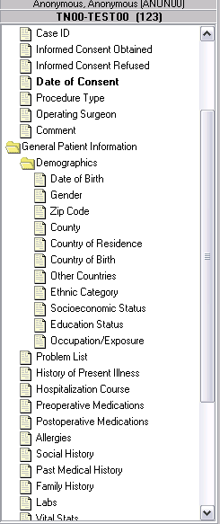
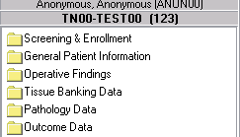
MAW3
Fields Captured in a Tissue Banking Report

Slide 23
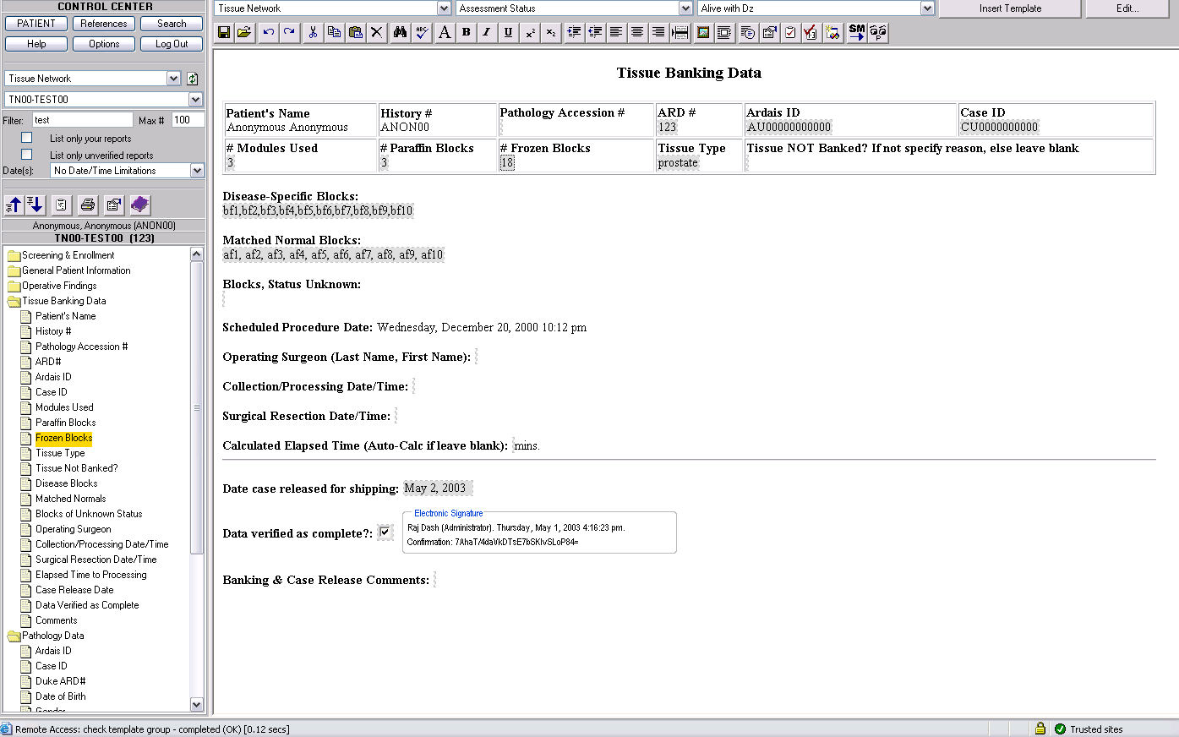
MAW3 – Tissue Banking Details

Slide 24
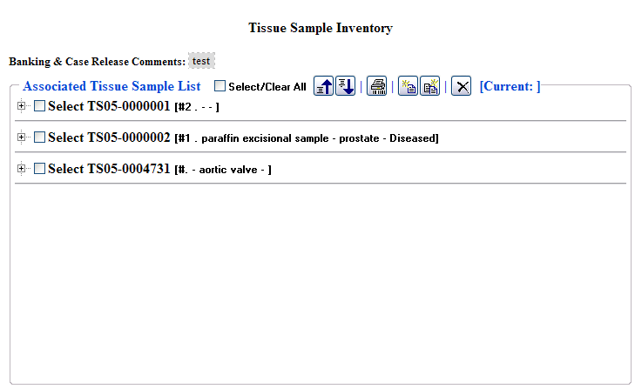
MAW3 – Inventory Management

Slide 25
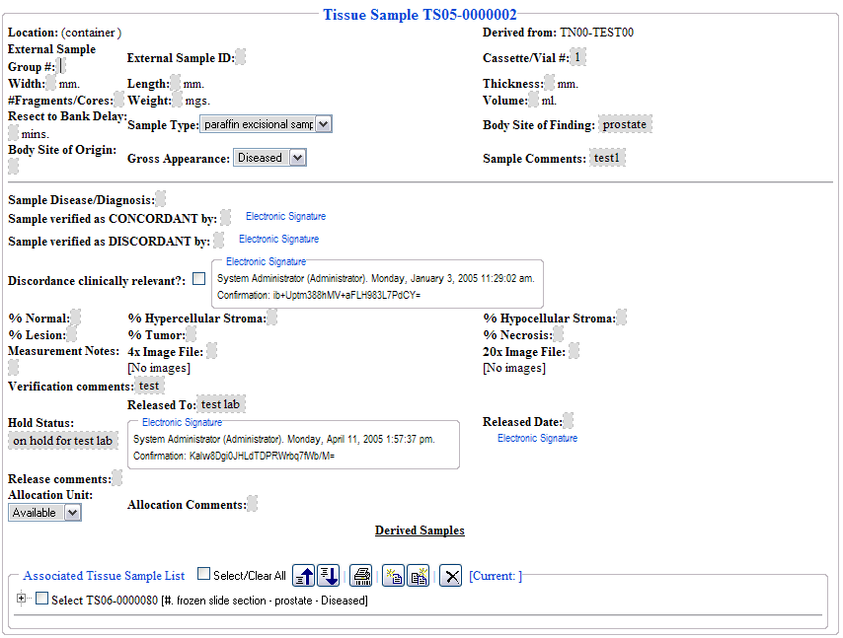
MAW3 – Inventory Management

Slide 26
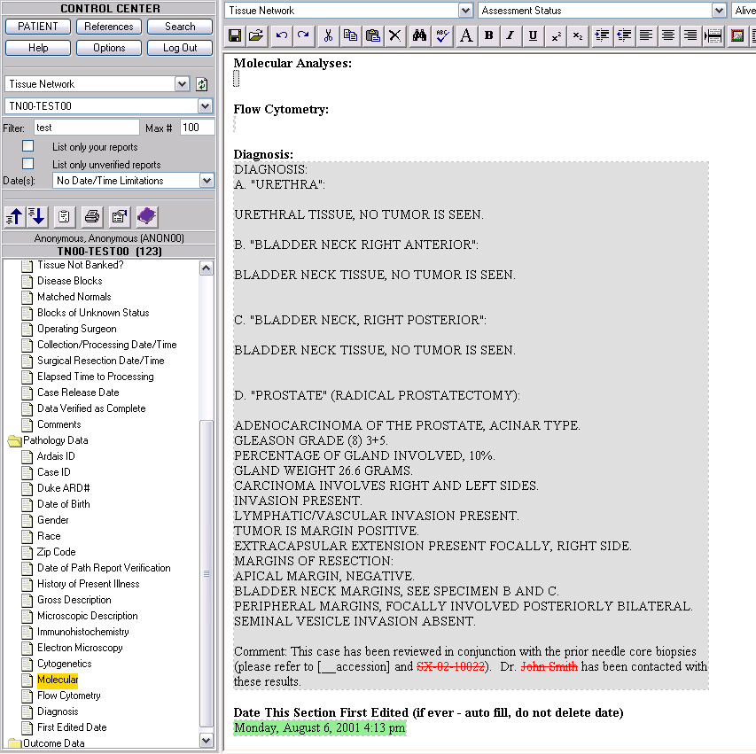
Pathology
Data
Privacy

Slide 27
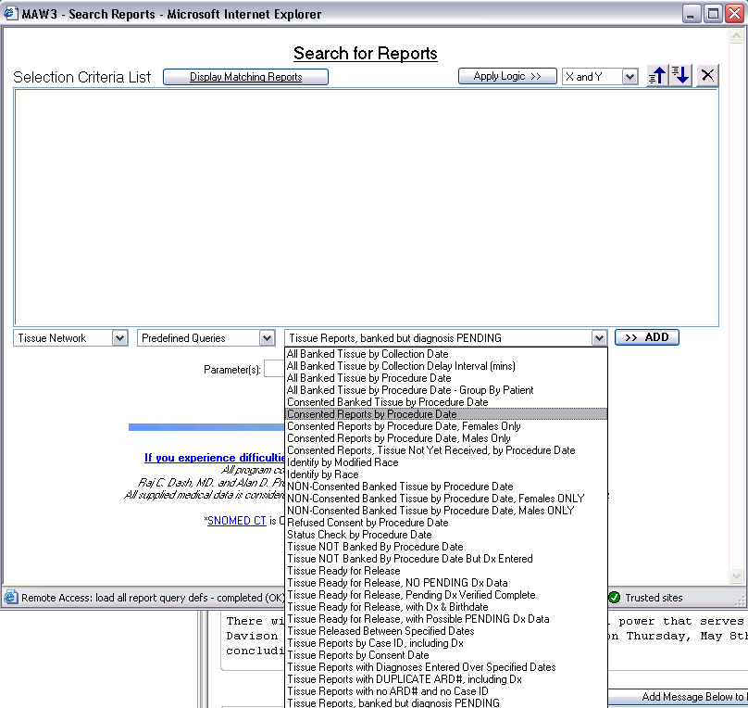
Sophisticated, Customizable
Query Tools
Custom “favorite” queries can be created and saved to facilitate periodic reporting

Slide 28
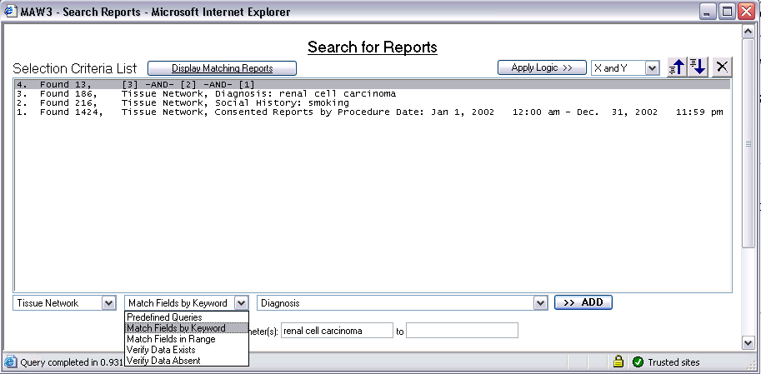
MAW3
Getting to the data that the donor researchers need

Slide 29
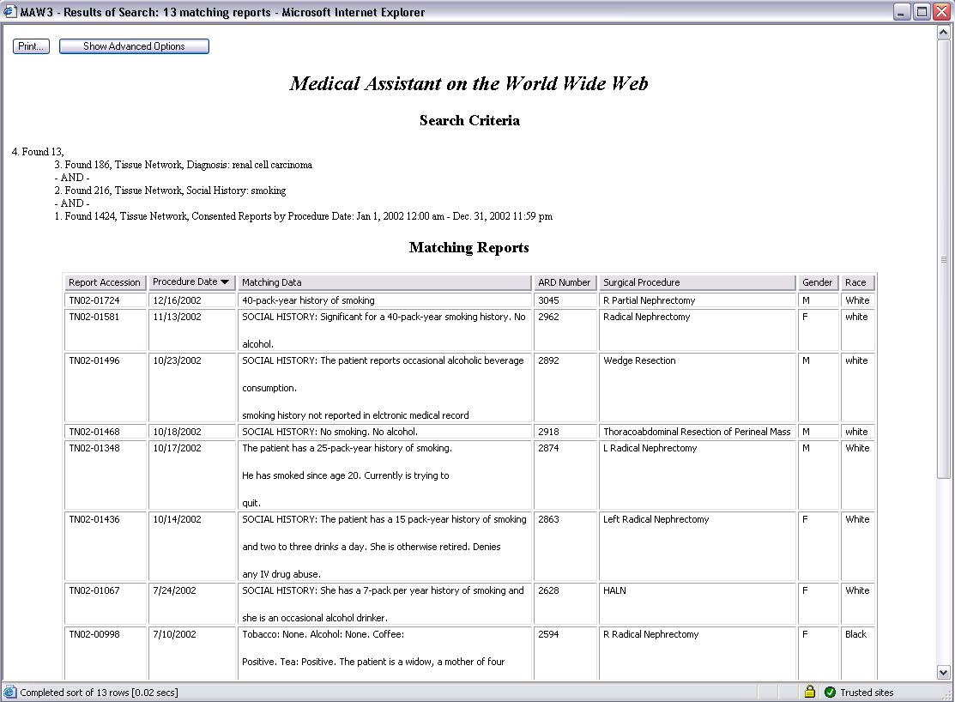

Slide 30
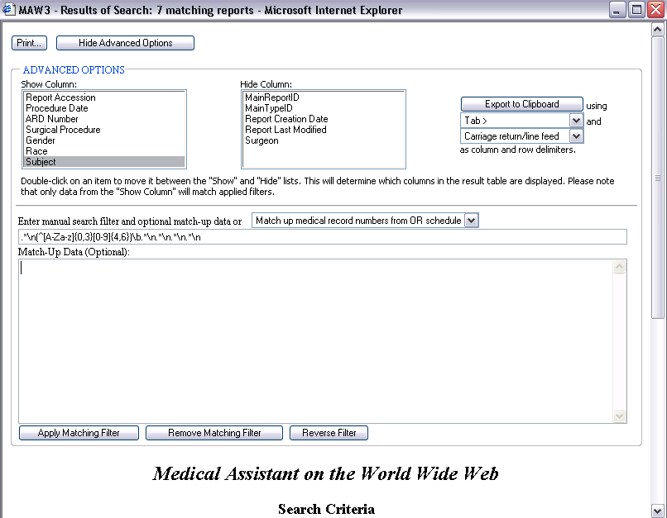

Slide 31
Questions?
E-mail: r.dash@duke.edu

